Slide 1
Classification of Dermoscopic Skin Lesion Images: Melanoma & Non-Melanoma
Jake Pistotnik, Jinsoo-Chung, Brian Tung
Notes:
Hi Everyone, today, myself, and my groupmates Jinsoo and Brian will be presenting our research on the classification if skin lesions: particularly between melanoma and other skin lesions

Slide 2
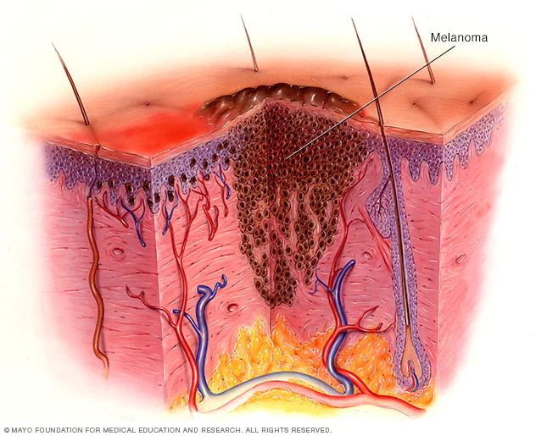
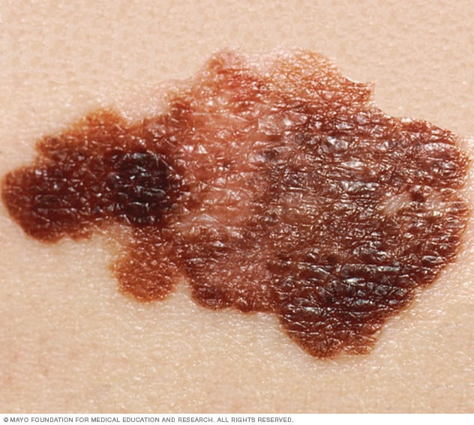
Background
Skin lesion = skin with different characteristics with surrounding skin
Melanoma = fatal form of skin cancer if not detected early
5 year survival rate = 99% if detected early
Characteristics of Melanoma:
Can form in any part of the body,
*UV Exposure
Grows and can spread to other parts of the body
Detection of Melanoma
Asymmetry
Border
Color
Diameter
Evolution
Notes:
Jake :
A skin lesion is any skin that has different characteristics compared to the skin around it. Most skin lesions are harmless although some may cause discomfort or pain. One type of skin lesion, however, Melanoma, is a type of skin cancer that can be fatal if not detected early. When detected early, however, melanoma has a 5 year survival rate of 99%
A few Characteristics of Melanoma:
-first off it Can form in any part of the body, especially parts with lots of UV Exposure
-Melanoma also Grows and can spread to other parts of the body
Now How do Detection of Melanoma visually in the absence of available lab testing? They look for:
-Asymmetry
-Clear Border
-Darker Color
-Diameter - tend to be 6mm or larger (unless detected early)
-Evolution of the lesion
Purpose:
-Build a binary classification model that can aid in the early identification of Melanoma versus non-melanoma images as it can can greatly improve patient outcomes and survival rate
-especially useful in areas of the world where lab testing for skin lesions is not widely available. This will lead to better early diagnosis and treatment of Melanoma.
The dataset we are using has images and metadata on 8 different skin lesions, one of them being melanoma,

Slide 3
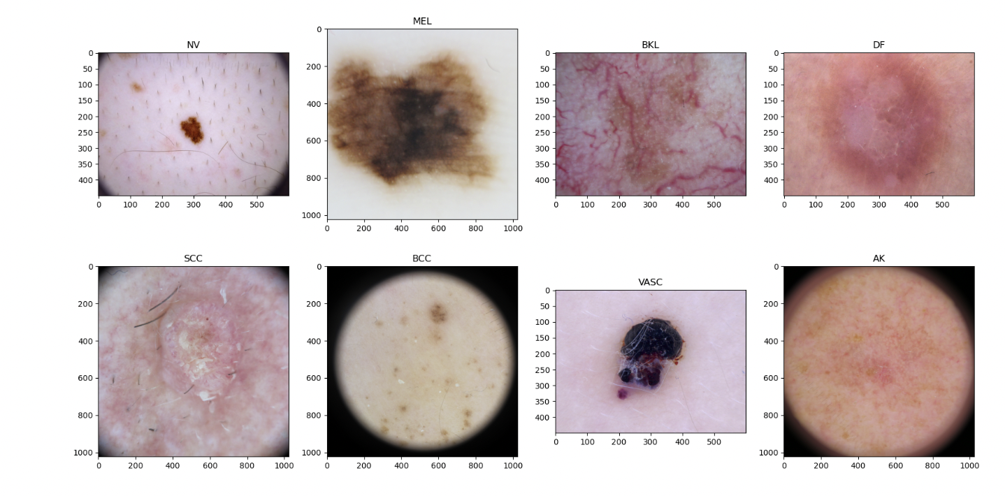
The Images
Notes:
Jake
To give some context of the images we were working with, this is a breakout of an example of each type of the skin lesion we have in our dataset: Melanoma, Melanocytic nevus, Basal cell carcinoma, and 5 other types of non-life threatening skin lesions. As you can see, there lots of differences in the skin lesions like the size of the lesion and the color of the lesion, appearance of hair, as well as differences in the photos themselves, things like their framing, the size of the photo, brightness, etc.. We knew we would need to take care of differences in the images themselves (not their content) in order to make our CNN classifier work well, as brian will talk about a bit later on in our data preprocessing.

Slide 4
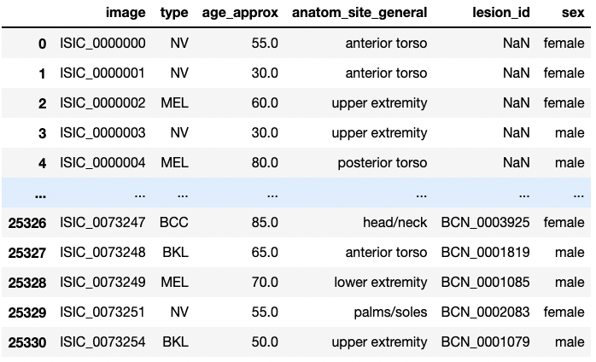
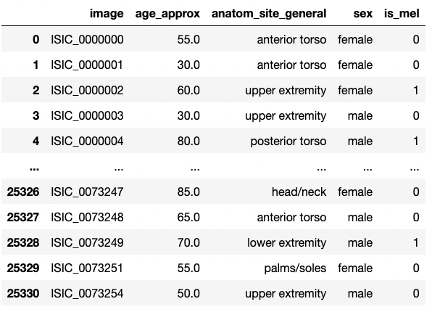
The Metadata
Notes:
Jake
in addition to the image data we had, we also had metadata on each image example, giving patient data such as sex, the general area of the body the lesion was found, the approximate age of the patient, and The ID of the lesion. Due to a high percentage of Null vlaues, we dropped lesion ID, and converted the type to Melanoma or not Melanoma.

Slide 5
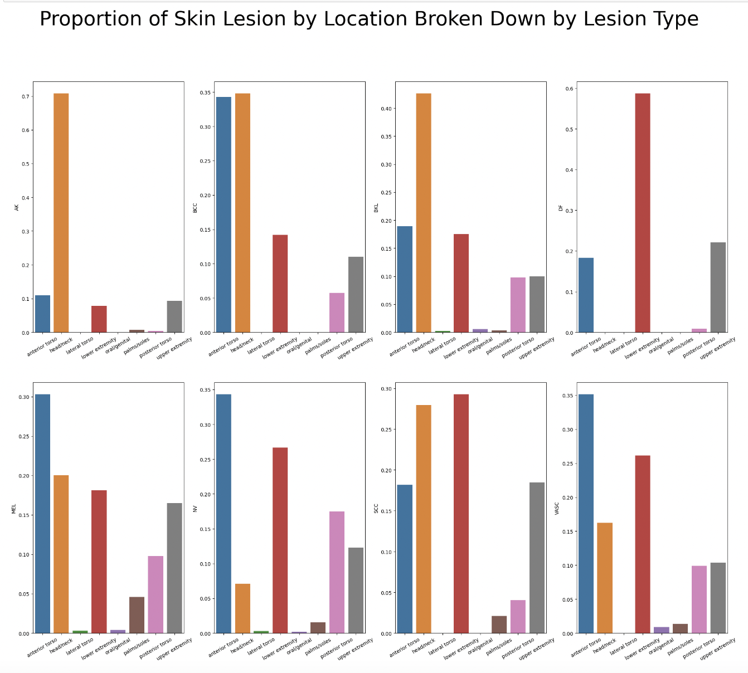
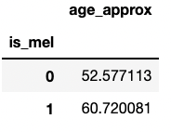
Metadata Visualizations
Notes:
Jake
We wanted to look into relationships between these variables and each of our 8 classes. Here are two that we found particularly interesting, showing skin lesion type occurs in different areas of the body at different rates. As we can see for melanoma, it is distributed fairly evenly across areas with high UV exposure the torso, head/neck, lower extremities, and upper extremities. Diseases like Actinic keratosis on the other hand, generally only develop on the neck (top left). IN addition, we can see from the snapshot on the right that on average, melanoma patients were 8 years older than non-melanoma patients. We felt this could be helpful in supplementing our Model later on. Now i will pass things along to brian to talk about our methodology and go deeper into our dataset, data processing, and sampling strategies.

Slide 6
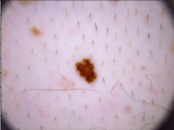
Methodology
Random
Data Split
Undersample by class
Transformations
Undersample by category
Augmentations
ISIC (2019) Dataset
Sampling
Image Preprocessing
Skin Lesion Classes
Melanoma (MEL)
Melanocytic nevus (NV)
Basal cell carcinoma (BCC)
Actinic keratosis (AK)
Benign keratosis (BK)
Dermatofibroma (DF)
Vascular lesion (VASC)
Squamous Cell Carcinoma (SCC)
CNN
Analysis
Random Forest
Binary Classification
Notes:
BT
Our study begins with the acquired dataset from the International Skin Imaging Collaboration (ISIC) Challenge in 2019, which is built upon data from previous years in 2017 and 2018. This dataset contains just over 25,000 dermoscopic images for classification across 8 diagnostic categories of skin lesions, which are listed below the image here. We then determined a sampling strategy that successfully provides enough input data for our model to learn, but also remains compatible with our processing power capabilities. These image samples would then go through the image processing step where transformations and augmentations are applied, before we feed the data into our binary classification model. Seeing how melanoma is one of the most aggressive and life-threatening skin lesion categories, our objective is to train a model that can accurately classify a dermoscopic image as melanoma or not melanoma.

Slide 7
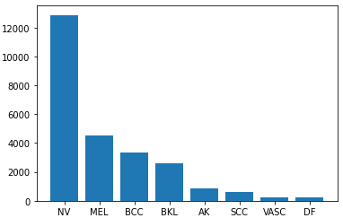
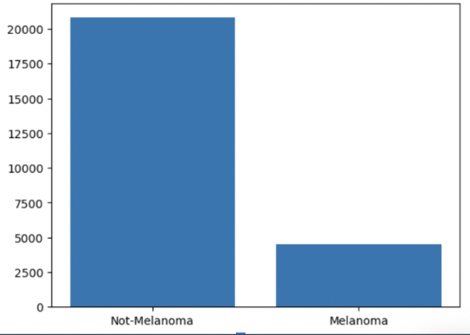
Data Context
Distribution of Skin Lesion Categories
Distribution of Skin Lesions (Mel vs. non-Mel)
Proportion of examples in MEL class: 17.86%
Notes:
BT
Before we built out our model, we wanted to understand the distribution across the diagnostic categories. As seen from the figures, the dataset had an imbalanced number of images in each skin lesion class, with the largest number of images belonging to the NV class (n=12,875). When we look at the breakdown of Melanoma versus non-Melanoma images, Melanoma images (n = 4,502) are much less represented compared to the totality of other classes (n = 20,809). This distribution had implications on the sampling strategy that we decided to use.

Slide 8
Sampling Strategy
Taking a random sample from our entire dataset
2) Undersampling from nonmelanoma class, maintaining even breakdown of non-melanoma subtypes
3) Undersampling from nonmelanoma class, ignoring subtypes of non-melanoma class, allowing for more total samples to be taken
4) Oversampling from our melanoma class using SMOTE sampling
Notes:
BT
In order to deal with our imbalanced data in building our model, we explored multiple sampling strategies in order to form a more balanced data set. This is critical is because if we only ran our model based off of a random sample of our data, our model will not have enough melanoma images to learn on, and will most likely overfit for our non-melanoma images.
We considered undersampling from the non-melanoma images by taking an equal number of samples from each of our 7 non-melanoma classes. We then sampled an equal number of melanoma images, to effectively double the total sample size. Although this is not representative of the true distribution from our original data, it creates equal representation for our CNN to learn how to classify between the two classes.
Another undersampling technique that we explored was splitting images up into their respective Melanoma vs. Non-melanoma classes while ignoring non-melanoma subtypes. We then sampled 2261 images (half of the total number of melanoma images) from each class. We chose this sample size due to memory and RAM constraints while augmenting our data set and running our CNN model.
The last sampling technique we explored was using SMOTE sampling in order to generate more melanoma image examples through a KNN classifier. Although SMOTE is traditionally a good method for overfitting underrepresented data, it was not the best technique due to computing constraints with RAM.
In our final analysis, we chose to utilize sampling technique 3, as it gave us the highest model accuracy and leveraged the largest number of images to train our model with.

Slide 9
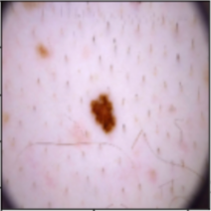
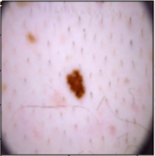
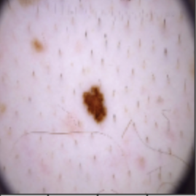
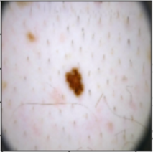
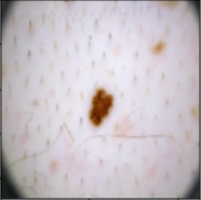
Data Preprocessing
Resize
Resize to
(200 x 200)
Brightness
Delta = 0.5
Contrast
Original Image
(300 x 225)
Random Flip
Left-right flip
Contrast Factor = 4
Notes:
BT
Prior to applying machine learning algorithms, it is crucial to assess the quality of the dataset through a variety of image augmentation and transformation techniques. Our analysis attempts to capture the significance of data quality on the ability for models to learn by comparing the model results of augmented data and non-augmented data.The preprocessing begins with splitting the sampled dataset into a 60:20:20 split for train, validation, and test sets. For all data splits, we applied image transformation by resizing all images to 200x200 pixels. The original images were larger, so resizing the image is critical for optimizing the model’s training efficiency. (not all images started same size, the (300,225) size was for memory purposes)
All image augmentation techniques were applied on the training dataset split only and are tuned to default values as follows: 1) Delta (brightness) = 0.5; 2) Contrast Factor = 4; 3) Left right random flip. We anticipate that applying image augmentation techniques will improve the performance of our model by increasing the amount of training data to learn our model. A larger amount of training data could also force the model to generalize all samples rather than overfit.

Slide 10
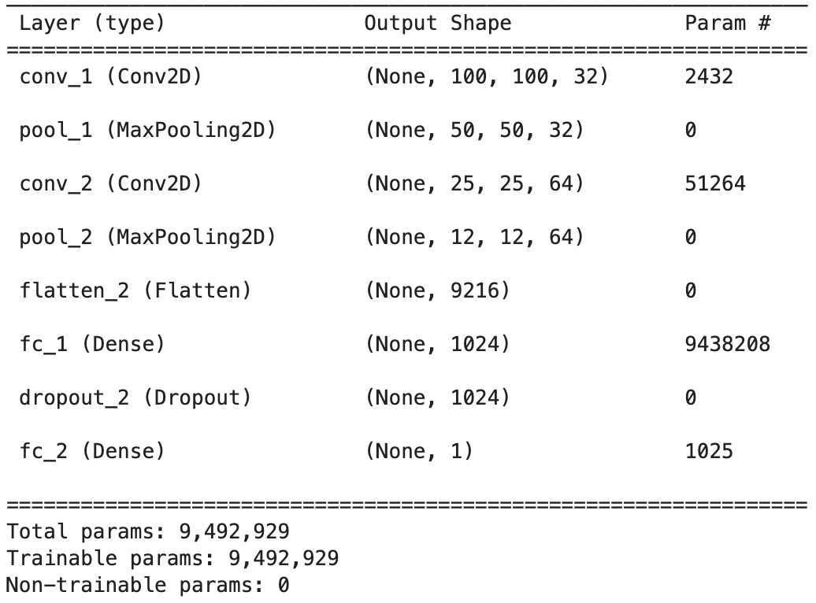
Model 1: CNN Results
Initial model ran with following parameters:
Optimizer: Adam
Learning Rate: 0.001
Loss Function: Binary Cross Entropy
Epoch: 20
Brightness: 0.5
Contrast: 4
Flip: True
Notes:
Jinsoo
We decided to utilize a convolutional neural network (CNN) as our first machine learning model due to the high-dimensionality of image classification problems, where each pixel is considered a feature. CNN’s convolutional layers are highly effective in reducing the number of parameters and complexity of images without losing on the quality of the model, which will improve computational efficiency.
In deciding the model specifications, we utilized common hyperparameter values used in image classification for the initial model: 1) Optimizer: Adam is one of the most widely adopted optimizers due to its characteristics as a computationally efficient and effective way to deal with large numbers of parameters. 2) Learning rate: Initially set to 0.001 3) Loss Function: “binary cross-entropy”. 4) Epochs: The epoch count is 20.

Slide 11
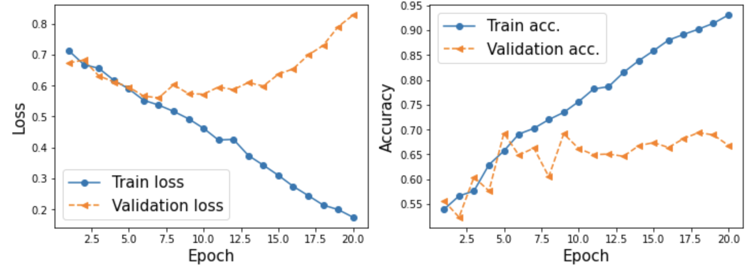
Model 1: CNN Results Cont.
Baseline Accuracy: 49%
Unaugmented data: Training Accuracy: 68% | Val Accuracy: 54% | Test Accuracy: 53%
Augmented Data: Training Accuracy: 93% | Val Accuracy: 66% | Test Accuracy: 64%
Notes:
Jinsoo
As expected, we achieved better model performance by training the model on augmented and transformed images compared to the original unprocessed dataset. Our CNN model was able to achieve a Validation Accuracy of 66% test accuracy of 64.00% for the augmented data. On the contrary, the model only achieved a test accuracy of 53.15% for the unprocessed data, which is a marginal improvement over the 48.83% baseline prediction for “not melanoma”.
We observed overfitting of the data beginning just after the 5th and 6th Epoch.

Slide 12
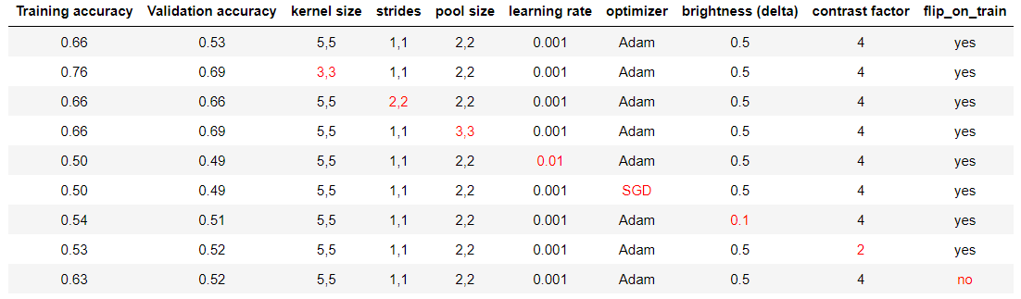
Model 1: CNN Hyperparameter Tuning
Explored hyperparameters one by one
Best parameter: Larger pool size & smaller kernel size
Notes:
Jinsoo
In order to improve the accuracy of the results, we ran through different hyperparameters to see how they would improve the training and validation accuracy of the results.The first line shows the performance of our initial model - we utilized a kernel size of (5,5), strides (1,1), and pool size (2,2) with an epoch of 5, seeing how we started to overfit around 5-6 epochs. We decided to tune one parameter at a time to check how they would improve or change the results from that of the baseline parameters mentioned above.
From the analysis, we found that decreasing the kernel size and increasing the pool size may help with the model . For the final model, we used a kernel size of (3,3), strides of (1,1), and pool size of (3,3) for our evaluation.

Slide 13
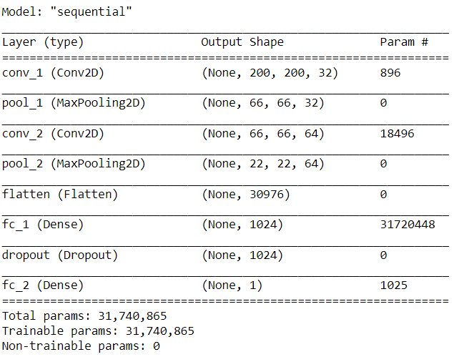
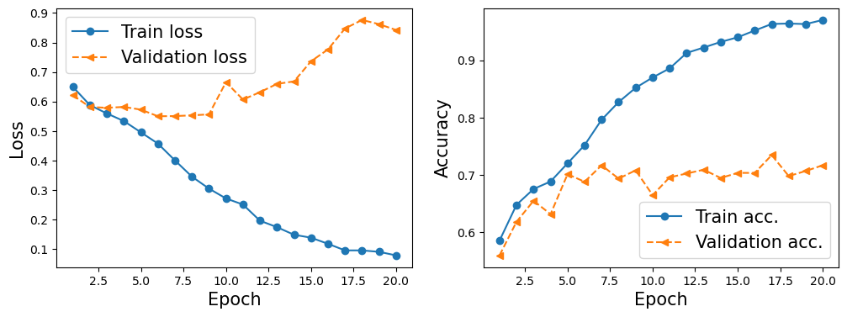
Model 1: CNN Final Results
Non-Hyperparameter Tuned Data: Training Accuracy: 93% | Val Accuracy: 66% | Test Accuracy: 64%
Hyperparameter Tuned Data: Training Accuracy: 97% | Val Accuracy: 72% | Test Accuracy: 71%
Notes:
Using the hypertuned parameters, we were able to bring the test and validation accuracy up to 72 and 71% respectively. This was an improvement over the non-hyperparameter tuned data, which had a validation and test accuracy of 66% and 64%, respectively. However, the final accuracy of 71% as a model is not great and may need to be significantly improved in order to be useful as a prediction model for Melanoma in real life.

Slide 14
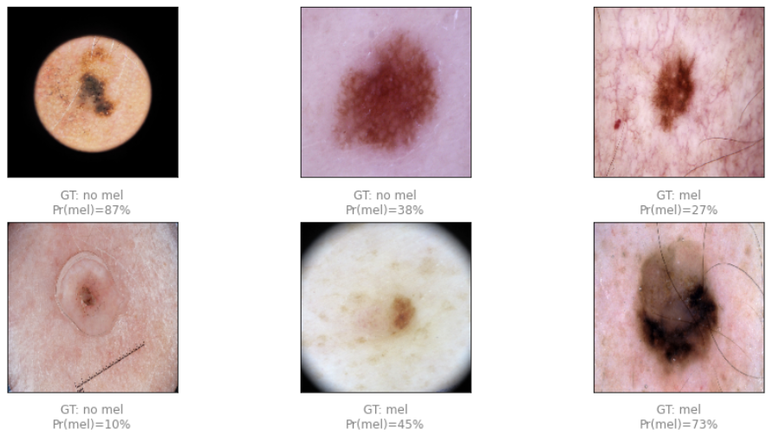
CNN Limitations
Inconsistent Image Quality
Low Computing Power
Large number of parameters and images yet low resource availability
Large time required for training per each hyperparameter setting
Notes:
Jinsoo
One of the most prominent limitation we faced was the inconsistent image qualities. As seen from the images above, the images don’t have a set orientation with some surrounded by dark space, and some have hair in the images. It appears that our model does a good job of classifying non-melanoma skin lesions that are lighter in color, but tends to classify all images that have a lot of darkness as Melanoma (whether due to the color of the skin lesion or the existence of hairs in the photos). To improve the model moving forward, it would be best to shave the area with the skin lesion as much as possible to reduce hair in the images, and implement a standardized system for how the photos of the skin lesions are taken.
Another limitation we faced was low computing power. CNN takes a lot of computing resources as the number of parameters in the model are in millions. Running through each epoch takes substantial time with frequent crashes due to low RAM availability. Having better computing power may help us run through more pre-processing and hyperparameters to build a better CNN model.

Slide 15
Model 2: Random Forest Decision tree
Pros:
Avoiding overfitting
Very Accurate for classification
Cons:
Very difficult to interpret
Can be time consuming
Notes:
Jake
Due to the underwhelming performance we got using our CNN, we decided to try and build out a Random forest Decision Tree classifier to see if we could get better results
Pros:
-Great for avoiding overfitting on your training data
-Tend to be very accurate for classification, using multiple trees to get a more accurate result sa compared to other decision tree classifiers
Cons:
-Very difficult to interpret, as random forest decision trees tend to be very complex and be hundreds of nodes deep
-Can be time consuming to run due to the vast amount of computation

Slide 16
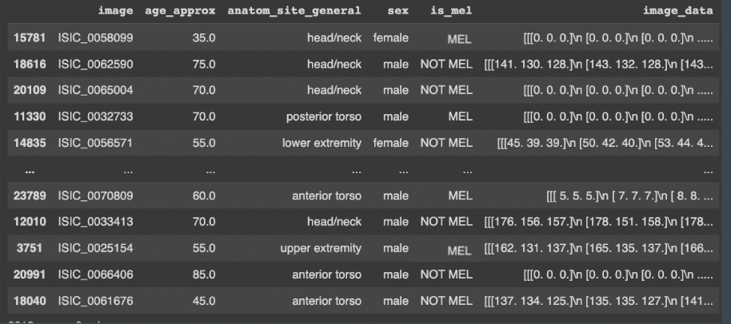
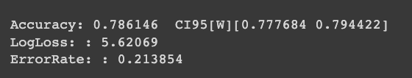
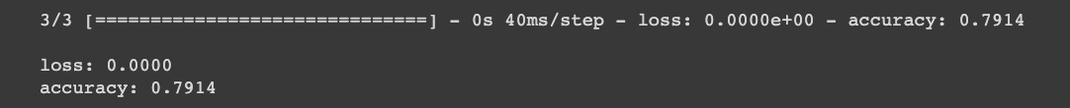

Model 2: Random Forest
Data:
Training Results:
Testing
Results:
Baseline
Accuracy: 51.64%
Notes:
Jake
For our random forest, we had to take a sample of 11,021 images and their metadata from our original tables and upload them into a colab notebook, as Tensorflows random forest decision tree is not compatible with the systems we had. We then split that data up into training and testing data. We trained the decision tree based on all of out categorical and numerical metadata columns, with the label being the is_mel columns.
As you can see, our Random forest decision tree was able to perform even better than our CNN model, achieving an accuracy if 78.61%. When compared to our baseline accuracy of that data of 51.6%, we can see that our Random Forest Decision Tree is performing much better than our CNN.

Slide 17
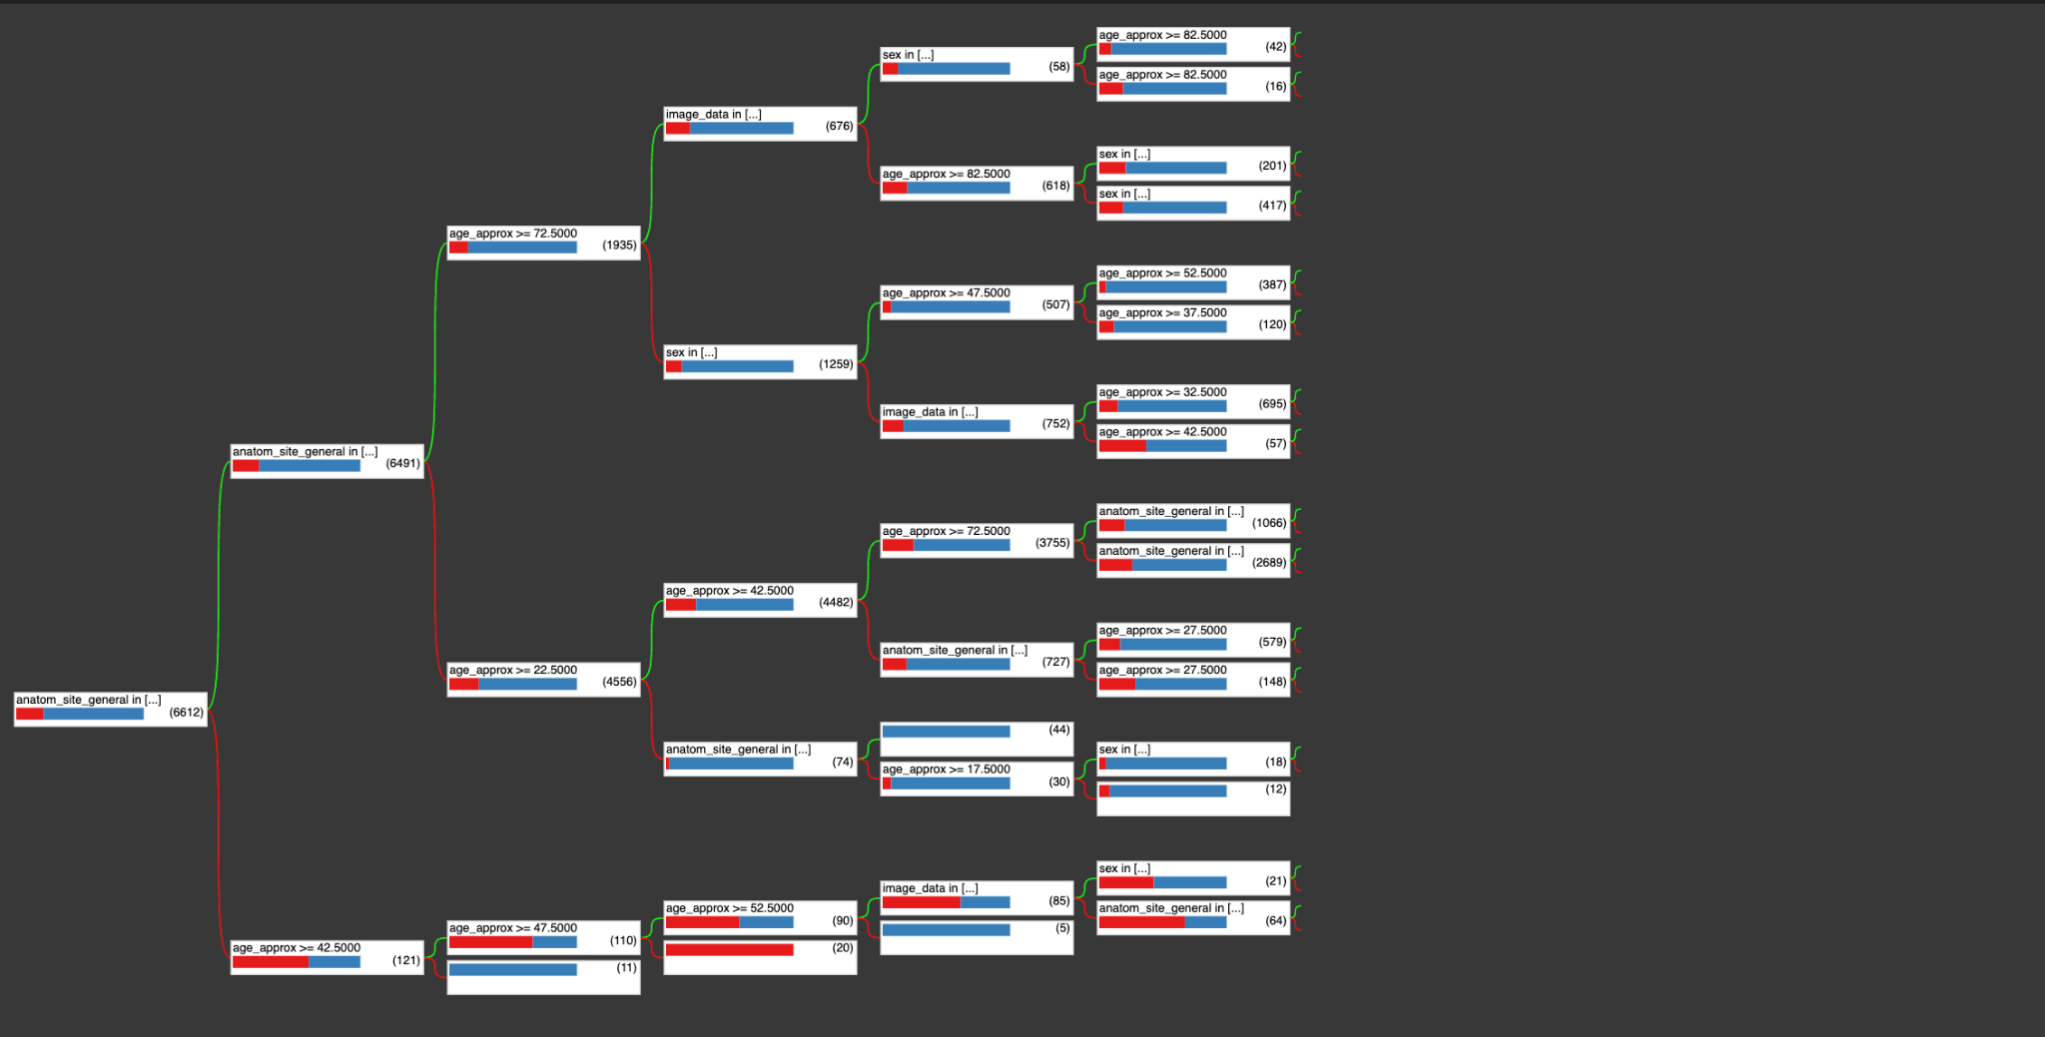
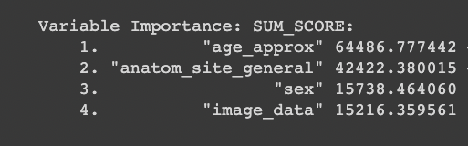
Model 2: Random Forest Graph
Notes:
Jake
Here is a graph of our decision tree cut out after 5 layers for the sake of readability. As we can see, Random forests are very complex and extremely difficult to interpret t, That being said, we can see that our model ranked our variables based off of their importance in the model, age_approximation being most important, followed by the location of the lesion on the body, followed by patient sex, finally follwed by the image data.
Overall, although the Random forest model did a better job of classifying our data than our CNN, the Random Forest still leaves us with lots of questions and requires us to put lots of faith in the Random forest model, without really understanding the underlying reasons of the results, which may not be acceptable in the medical field.

Slide 18
Conclusion
Better, more standard images
Clean shaven for more visibility
Consistent framing, distance
More Computational Power
Working with doctors, health professionals, and patients
Notes:
In conclusion, in order to improve our CNN, we need a few different things:
First off, we need Need better, more standardized images to train our CNN on. By setting standards like: area of lesion must be shaven and pictures should be taken with a specific framing and at a specific distance, we can train our model on cleaner data and make it more accurate
We also need More RAM and computing power to leverage more images, as we mentioned earlier, we were only able to capitalize on so much of our data due to our computation power constraints, so having access to more RAM and CPU power would help our analysis greatly.
Finally, we need to working with Doctors and patients to improve knowledge around these skin lesions and obtain more metadata around the images with information like how long the skin lesion has been on the body, how much (approximately it has grown), etc.
With these tools, we can increase the usefulness of our CNN and random forest and use them to help better identify melanoma

